Slide 1
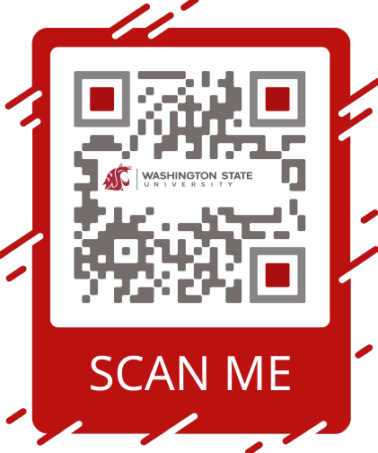


Bursar’s Office
We are here to help!
New Coug Orientation – Summer 2024

Slide 2
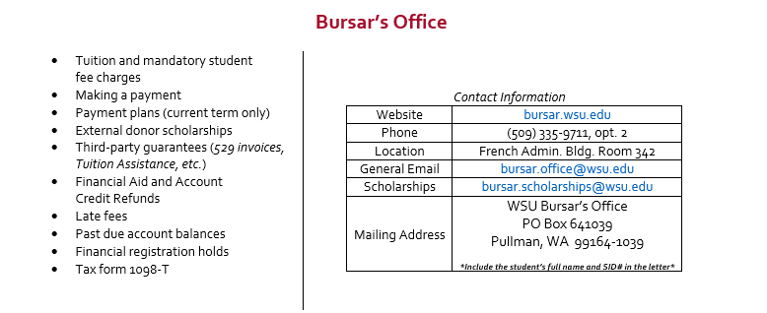
Who We Are

Slide 3
Important Dates
August 19th – First Day of Classes / Tuition & Mandatory Fee Payment Due
September 5th* – 1st late fee** posts, 3%
September 17th* – 2nd late fee** posts, 5%
October 2nd* – 3rd late fee** posts, 7%
* TBD – will be posted on the Academic Calendar https://registrar.wsu.edu/academic-calendar/
** Non-payment plan enrollees
Notes:
August 22, 2022 – First Day of Fall 2022 semester
Term withdrawal fee applicable once 1st day of the semester begins

Slide 4
Paying Your Student Account Balance
Student Payments can be accepted:
  mailing into the Bursar’s Office
      WSU – Bursar’s Office
      PO Box 641039
      Pullman, WA 99164-1039
  in-person payment with Cashier’s in Bursar’s Office
    Cash
    Check
  online via Student Account portal
    eCheck
    VISA / MC / Discover / AmEx (with 2.95% convenience fee)

Slide 5



WSU -
Payment Plans
Bursar’s Office
WSU
Payment Plans will combine tuition & housing charges only
Payment Plans offer the option to make payments of equal installments throughout the semester
Low setup fee = $50 per plan/semester
Automatic email notifications for upcoming payments
Automatic payment adjustments based on additional aid awards / payments
Payment Plans will be available to most Students
Payment Plans link will be available August 14th via the Student’s payment portal area

Slide 6

How to enroll in Direct Deposit
Log into your MyWSU student account and locate “Account Services & 1098-T” tile
Click on link for “Enroll in Direct Deposit” twice and follow prompts
Reminder: there is a 2-Part submission process
** Visit our website for step-by-step instructions

Slide 7
Why signing-up your Parent/Supporter for Third-Party Access is Important
Regulation FERPA – Family Educational Rights and Privacy Act
Student is responsible to enter the access information
An Authorization Code is very important for over the phone/email access
Access to 1098-T digital form
Answer any questions about your student account information
**Visit our website for step-by-step instructions

Slide 8
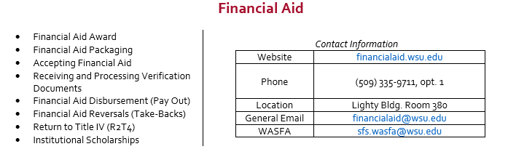
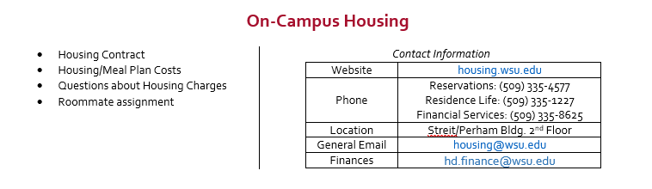
Helpful References

Slide 9
Connect with Us:
Bursar’s Office
WSU
Website Location
www.bursar.wsu.edu French Admin. Bldg. Room 342 * West side of the building near the
Phone entrance from sky bridge *
(509) 335-9711, opt. 2
Mailing Address Emails
WSU Bursar’s Office bursar.office@wsu.edu
PO Box 641039 bursar.scholarships@wsu.edu
Pullman, WA 99164-1039 * Don’t forget your Designation Form *
* Include the student’s full name and SID# in the letter or on the check *
And Remember…
Check Email and Student Account frequently
Organize Classes on the same day (Add/Drop)
Update address
Get Third Party Access created
Set up Direct Deposit

Slide 10
Scan and Save
Scan and Save

